Slide 1

Get Ready to Train in the New Semester
Steps to Launch or Re-Launch Your Training

Slide 2

Agenda
Introductions
The Training Launch Cycle
  Defining
  Creating
  Enrolling
  Communicating
  Monitoring
Your Team
Q&A
Launch Checklist | Add/Remove a TA Form | Admin Guides
Fall 2025 Training Kickoff

Slide 3

Parts of the Slide
The orange pop-up boxes will highlight key takeaways and common mistakes.
The boxes in the bottom-right corner will contain useful links to guides and resources throughout the presentation.

Slide 4
Learning Enablement Team
Kevin Smith
John Williams
Jodi Dobinsky
Sophia Portlas
Jason Chernauskas
Alex James
Manager of Learning Enablement
Senior LMS Administrator
RM Systems Administrator
Implementation Success Consultant
Implementation Specialist
Member Success Specialist

Slide 5
Online Training at United Educators
No additional cost for members with eligible policies
  Part of Risk Management value-add
UE Learning Portal runs on a Learning Management System (LMS)
  Current platform, Docebo, in use since 2024
Over 70 courses
  Course pipeline based on top areas of risk and member requests
Can be used with your employees, students, volunteers, and contractors.

Slide 6
Course Offerings & Areas of Risk
Discrimination Prevention
  Age Based Discrimination
  National Origin & Race Discrimination
Athletics
  Hazing
  Concussion Awareness
  Heat Illness
Compliance
  HIPAA
  FERPA
  Protecting Payment Card Information
  Clery Act
Crisis Management
  Crisis Response
  Campus Violence Prevention
Data Security
Diversity, Inclusion, and Accessibility
Health and Well-Being
  Drugs & Alcohol
  Bloodborne Pathogens
  EpiPen
  Mental Health
  Bullying
Slips, Trips, and Falls
Sexual Assault Misconduct
  Protecting Minors
  Title IX
  Study Away
Transportation Safety
  Golf Cart
  Van Safety
  Defensive Driving
  Driver Safety Fundamentals
UE Course Catalog

Slide 7
The Training Launch Cycle
Creating
Self-Registration
Manual Creation
Enrolling
Direct Course Enrollment
Learning Plans
Bulk Upload
Automated User Creation
Monitoring
Communicating
Crafting Your Announcement
Standard Reports
Custom Reports
System-generated Notices
Defining
Who & What
Addressing Differing Needs
Automated Enrollment Rules

Slide 8
Define Your Overall Initiative
Who needs to be trained?
What courses do they need?
Employees?
Students?
Volunteers?
Contractors?
Does everyone need the same courses?
Does everyone need them at the same time?

Slide 9
Overlapping Populations
All Employees
Athletics
TIX
Concussion Awareness
Data Security
Passenger Van Safety
Slips, Trips, and Falls
Supervisors
Supervisor in the
Athletics Department
All of the above
Avoiding Supervisory Pitfalls

Slide 10
Choose a Registration Method
Questions to Consider
Is my population stable or frequently changing?
02
Can I pull a list of users from our HR or student systems?
03
Do I want to create accounts for learners or have them create their own?
01

Slide 11
Choose a Registration Method
Overview of Options
 | Created By | Recommended Use | Example groups
Self-Registration | Learner | Ad-hoc, rolling, or opt/in-optional training Undefined or frequently changing populations | Volunteers, contractors, new hires
Bulk Upload | TA or UE Team | Static or largely static populations | Students, employees
Manual Creation | TA | Small populations Learners who aren’t comfortable self-registering Late additions to an already uploaded population | New hires being added to an existing all employee training
Automated User Transfer (SFTP)* | Automated system process | Frequently changing populations Supporting an SSO setup | New hires or populations with overlapping training initiatives based on profile data (department, supervisor, role, etc)

Slide 12
Choose a Registration Method
Self-Registration
Unknown or frequently changing populations like volunteers or new hires
Opt-in training like driver authorization
Limitations
Learners aren’t trackable until they create an account
You can’t control what email address or name they use
Recommended Use
Generating a Self-Registration Link for a Specific Course | Generating Self-Registration Links for Learning Plans

Slide 13
Choose a Registration Method
Bulk Upload
Recommended Use
Static or largely static populations like students & employees
Mandated trainings
Large populations (10+)
Adding additional optional profile data (department, role, supervisor, etc)
Limitations
Must be created before announcing the training
Processed by TA or sent to UE
User Bulk Upload | Bulk Upload Template | Submit Your File to UE

Slide 14
Choose a Registration Method
Manual Creation
Recommended Use
Small populations (>10)
Learners who aren’t comfortable self-registering
Late additions to an already uploaded group of users
One-off additions, like new hires
Limitations
Time intensive
Repetitive
Must be created by TA
Manually Creating a New User
Fall 2025 Training Kickoff

Slide 15
Choose a Registration Method
Automated User Transfer
Recommended For
Large or frequently changing populations
Institutions with an HRIS/SIS
Institutions with complex/overlapping training initiatives based on profile data (department, supervisor, role, etc)
Limitations
May take up to a week to configure
Must be configured by your IT department
Additional Notes
Can also be used to send completion data from the learning portal to your institution’s HRIS/SIS
Configuring an SFTP Connection for Reporting & User Creation Information Page
Fall 2025 Training Kickoff

Slide 16
Enrolling Learners
Direct Course Enrollment vs Learning Plans
Direct Course Enrollment
Set soft deadlines
Both
Provide certificates of completion
Learning Plan Enrollment
Allows learners to enroll in multiple courses with a single enrollment link
Allow learners to re-enroll themselves, but deletes course completion data in the process
Easiest for learners to navigate
Quickest setup
Set hard deadlines
Can be used when enrolling learners in one or more multiple courses
Most recommended
Courses can be set as optional
Work with all registration methods
Learning Plan vs Course Enrollment Recommendation Tool | Course Enrollment
Fall 2025 Training Kickoff

Slide 17
Archiving and Re-enrolling
Learners’ completions must be archived and re-enrolled in each course to allow them to earn a new certificate.
Archived completions are saved and still accessible for reporting.
Required for both Learning Plans and Direct Course Enrollment
Learners can’t retake courses and earn new certificates unless you archive their completion records.
Archiving and Re-enrolling Guide

Slide 18
Automations
Enrollment Rules
Rules that automatically assign learners to courses, learning plans, or groups based on profile data such as department, role, or other custom fields.
  Ex: Enroll anyone marked as a Supervisor into Avoiding Supervisory Pitfalls and the AllEmployeeAnnualTraining Learning Plan.
Can be used for both new and existing users who meet the criteria you’ve set.
Must be configured by the UE team.
Automating Enrollments
Fall 2025 Training Kickoff

Slide 19
Communicating
You must include the branch code in your self-registration announcement
What to Include in Your Announcement
Self-Registration/Enrollment
Link to the learning portal (learn.ue.org)
Bulk Upload, Manual Creation, or SFTP
System-generated link to the specific course or learning plan
Your institution’s branch code
Username & Password
Templates and Sample Language
Fall 2025 Training Kickoff

Slide 20
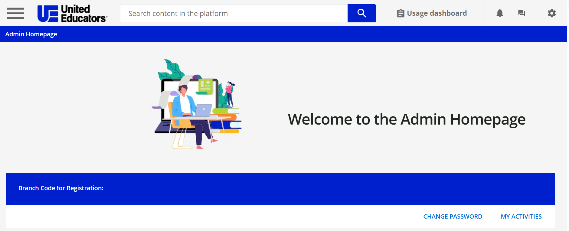
Branch Code
Available in the middle of your admin homepage
1234-321

Slide 21
Communicating
Enabling Account Creation Alerts during a bulk upload only sends notices to new users.
System Generated Emails – Creation & Enrollment
You can choose to have the system send out notices when a learner account is created or they’re enrolled in a training.
Account Creation Notice: Can be enabled at the time of manual creation or bulk upload by whoever is creating the accounts (TA or UE). Sends notifications to new users only.
Course Enrollment Notice: Sends an email to the learner that lists the courses they’ve been enrolled in at the time of enrollment. Must be enabled by UE before learners are enrolled.
Email Notifications

Slide 22
Communicating
System Generated Emails - Reminders
Most Used Notifications
  Course Enrollment Reminder: A weekly digest email that goes out to the learner on Monday mornings to remind them that they are enrolled in a course and haven’t completed it yet.
  TA Course Completion Notice: Emails the TA every time a learner completes a course.
  Course Expiration: A reminder sent to the learner 14 days before their course enrollment expires (only available if you’ve set a course deadline).
How to Enable Them
  Notifications cannot be enabled directly from the TA portal.
  Email the UE team at launch@ue.org enable them.
Email Notifications
Fall 2025 Training Kickoff

Slide 23
Monitoring Completions
Standard Reports
Access individual records both active and archived.
Useful for one-off checks.
Course Report Pages
Track progress for a specific course.
Can be downloaded as a PDF through the Reporting page or spreadsheet through the Course Management page.
Insights Page
A visual dashboard that provides a high-level overview of trainings.
View trends and export information to CSV.
Learner Profile View
Running Reports & Viewing Learner Completion Data | Viewing Archived Completions | Accessing Course Reports
Fall 2025 Training Kickoff

Slide 24
Monitoring Completions
Custom Reports
Create new reports or duplicate and edit UE Created reports to suit your specific needs.
Filter by additional fields on learner profiles.
Share reports with other TAs.
Schedule reports to be emailed to any valid email address (including non-TAs and departmental emails).
Running Reports & Viewing Learner Completion Data | Creating Custom Reports | Viewing Archived Completions | Accessing Course Reports
Fall 2025 Training Kickoff

Slide 25
The Training Team
Your Team
Training Administrators (TAs)
Recommend 2-3 per training initiative when possible
Create additional TAs with form below
Get them involved early in the process!
Provide them with the IT Tip Sheet to whitelist system emails
Your Safety Net
Learner Support
Direct learners to Tier 1 Support: uekb.blackbelthelp.com
Training Admin Support
TA Guides and Resources Homepage
Reach out to your learning contact directly (Sophia or Jason) or email us at launch@ue.org
Managers or Limited TAs
Give others the ability to pull reports and keep track of just their team
Your Institution's IT Department
They can submit a ticket, chat, or call
Tickets will be escalated to us if Tier 1 is unable to resolve the issue
IT Tip Sheet | Training Admin Guides & Resources | Add/Remove Training Administrators

Slide 26

Q&A

