Slide 1

Leveraging United Educators Online Training for Proactive Risk Management

Slide 2
Agenda
Welcome & Introductions
Training at UE: Purpose & Value
Getting Started & Implementation Options
Real-World Examples
Preventing and Overcoming Challenges
Q&A

Slide 3
Speakers
Jodi Dobinsky
Sophia Portlas
RM Systems Administrator
Implementation Success Consultant
Natalie Robinson-Babaniyi, Esq.
Risk Management Consultant
Notes:
Slide 3: Learning Enablement Team
First, I’d like to introduce the Learning Enablement Team, the folks behind the scenes who help implement and oversee the Learning Portal.
Kevin Smith, our team manager.
John Williams and Jodi — they are the LMS Admins, responsible for system stability and backend configuration.
Myself, Sophia, and our newest team member, Jason Chernauskas, make up the Implementation Team. They’re your go-to contacts for anything related to UE training.
And finally, Alex James, our Member Success Specialist. She monitors the inbox at launch@ue.org, answers your questions, and routes cases to the right team member.
If you’ve worked with us before, you might notice a few title changes. But rest assured — regardless of our roles, we all work together to support you and ensure your training initiatives are successful.

Slide 4
Training at UE: Purpose and Value

Slide 5
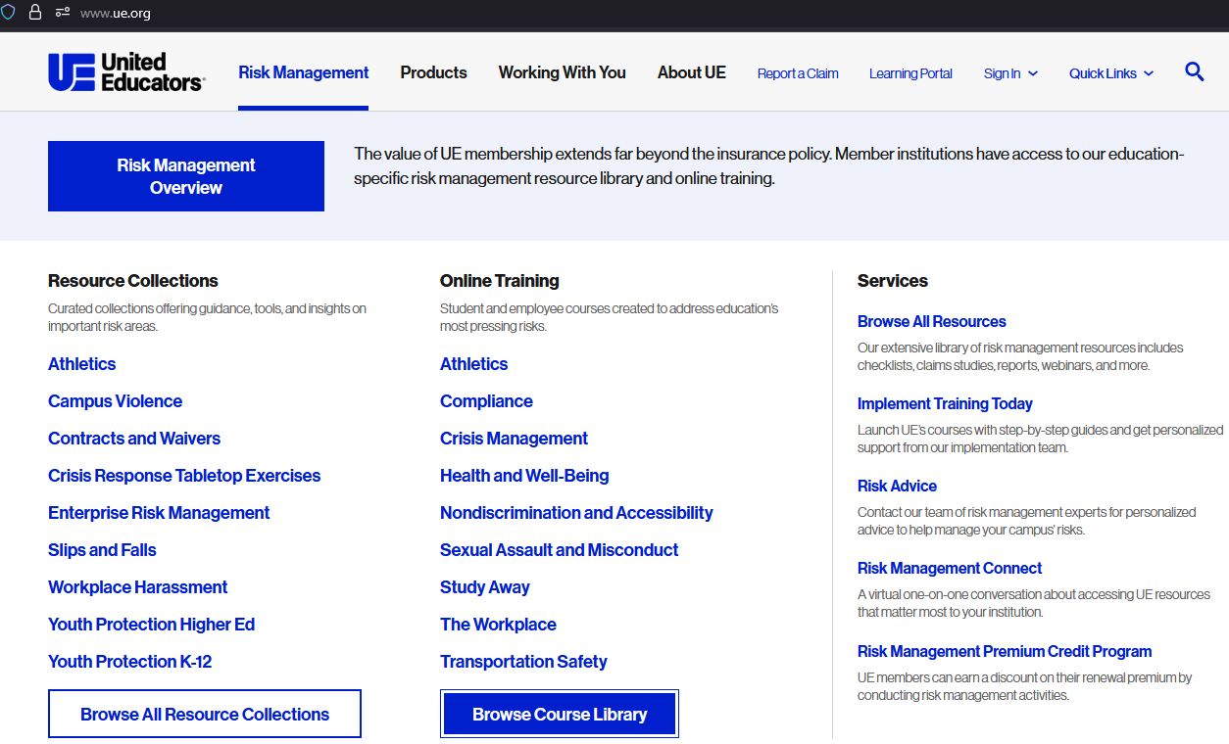
Explore Our Courses on UE.org

Slide 6
UE Online Training: Big Picture
Proactive Risk Management Benefit for Members
  Included benefit for eligible UE members at no additional cost
  Higher education & K–12 specific courses
  Unlimited access to courses and number of learners
  Designed to prevent incidents before they become claims
Flexible Delivery Options
  UE Learning Portal (reporting & tracking included)
  Self-hosted option (SCORM compatible)

Slide 7
Training as Part of Risk Strategy
Extends Risk Management Across Campus
  Reaches employees and students at scale
  Reinforces that risk management is a shared responsibility
  Moves beyond designated “risk owners”
Training Turns Policy into Practice
  Policies set expectations; training drives understanding
  Clarifies roles in day-to-day risk decisions
  Ensures standards are usable in real situations

Slide 8
High-Impact Training vs. "Checkbox" Compliance
High-impact training changes behavior; checkbox training tracks attendance.
Focuses on course completion
High-Impact Training
Checkbox Training
Measures participation, not behavior change
Exists primarily to satisfy compliance requirements
Influences behavior & strengthens risk culture
Meaningful & relevant to real-world scenarios
Clearly connected to learners’ roles
Supported by leadership
Encourages practical application

Slide 9
Proving Value, Targeting Risk
Show the Risk Impact
  Use leadership language: exposure, trends, and measurable outcomes. Manage training as a named control with clear ownership and metrics.
Prove the ROI
  One avoided claim can offset costs many times over. The return is financial, reputational, operational, and cultural.
Target What Matters Most
  Prioritize high-risk audiences and deliver focused training where it will reduce exposure most.

Slide 10
Getting Started & Implementation Options

Slide 11
Launching UE Training: Step One
Define Your Overall Initiative
Who is your audience?
Is this annual compliance or targeted training?
What risk or requirement are you addressing?
Then Align the Courses
Identify UE courses that match your goals
Build the launch plan around defined outcomes

Slide 12
Hosting Options for Online Training
Institutions may use both hosting options simultaneously for different populations.
Turnkey solution
Self-Hosting
Best for institutions with an established LMS
UE Learning Portal
Built-in reporting & automations
Automated notifications & deadlines
Implementation support included
Reduces learner logins
Integrates with existing systems
Licensing agreement required

Slide 13
The Training Launch Cycle
Creating
Self-Registration
Manual Creation
Enrolling
Direct Course Enrollment
Learning Plans
Bulk Upload
Automated User Creation
Monitoring
Communicating
Crafting Your Announcement
Standard Reports
Custom Reports
System-generated Notices
Defining
Who & What
Addressing Differing Needs
Automated Enrollment Rules
Notes:
Today we’ll be discussing the Training Launch Cycle and the process you’ll go through to launch and re-launch your training each year.
Defining Your Initiative
Creating Your Users
Enrolling in Courses
Communicating the Training
Monitoring Progress
Please keep in mind that we won’t be going through the step-by-step process for each of these components. Instead, we’ll be talking more about how to choose which option for each step is right for you and your learner. Each slide will also include links to relevant guides to help you walk through the configuration process. You are also always welcome to drop questions in the Q&A section, schedule a time with your learning specialist directly, or reach out to launch@ue.org for more information.

Slide 14
Real-World Examples

Slide 15
Example 1: Annual Fall Training
Situation
Mid-sized higher education institution preparing for annual fall compliance training
Goal
Launch training early to avoid the fall rush
Optimize (not rebuild) the training process
Improve overall user experience for learners and TAs

Slide 16
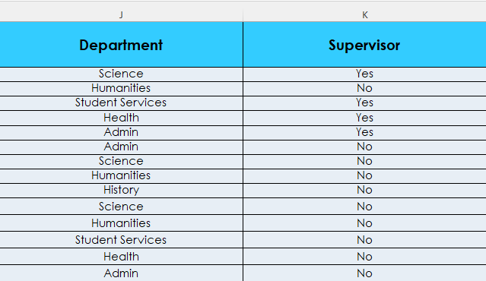
Example 1: Launch Process

Slide 17
Example 1: Key Takeaways
What Made the Difference
  Automation reduced manual effort
  Enrollment rules ensured accuracy
  Reminders kept training top of mind
  Early planning avoided last-minute scrambling
Result
  Smoother rollout, fewer support requests, and higher participation.

Slide 18
Example 2: Authorized Drivers
Situation
Institution identified vehicle use as an exposure risk
Goal
Target the right audience despite a fluid population
Minimize administrative lift while maintaining compliance

Slide 19
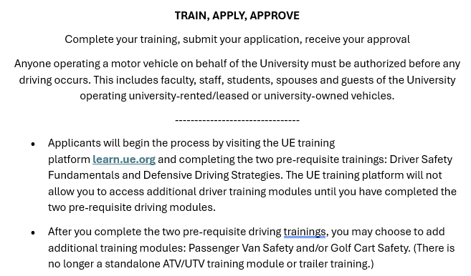
Example 2: Launch Process

Slide 20
Example 2: Key Takeaways
What Made the Difference
  Training was anchored to a specific trigger
  Self-registration was embedded in the driver authorization workflow
  Completion was required before driving approval moved forward
Result
  Targeted compliance without manual enrollment or ongoing list management.

Slide 21
Example 3: Group Training
Situation
K-12 school working towards earning their Risk Management Premium Credit (RMPC)
Goal
Reduce administrative burden
Remove access and language barriers
Complete training on schedule to receive the RMPC

Slide 22
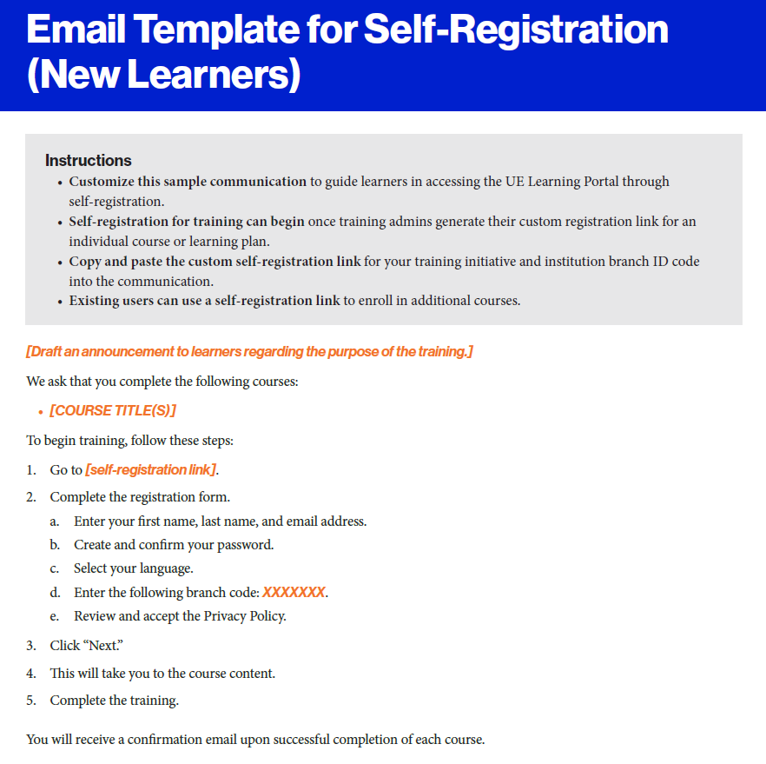
Example 3: Launch Process

Slide 23
Example 3: Key Takeaways
What Made the Difference
  Centralized, in-person training session
  Leadership support from the Head of Maintenance
  Bilingual step-by-step instructions
  Dedicated time blocked on team schedules
Result
  Full team completion that satisfied the RMPC goal with minimal administrative strain.

Slide 24
Preventing and Overcoming Challenges

Slide 25
Participation: Risks & Drivers
Low Training Participation Leads to:
  Awareness gaps, inconsistent practices, and increased institutional exposure
Why Does Participation Lag?
  Inconsistent enforcement
  Training feels untimely or irrelevant
  Unclear or misaligned leadership expectations
What Improves Participation?
  Clear communication of “why”
  Supervisor & leadership support
  Connect training to real responsibilities

Slide 26
Technical Support
Involve IT early
  Awareness of training effort
  Whitelist emails from the Learning Portal
  If self-hosting, ensure platform compatibility
Leverage Available Support
  24/7 learner support through the helpdesk (UE Learning Portal)
  Multi-channel help: articles, chat, email, phone, ticket
Administrator Support
  launch@ue.org
  Book a call with our team

Slide 27
Managing Workloads & Priorities
When training is manageable and well-communicated, completion rates improve.
To Increase Completion:
  Launch at the right time
  Keep training digestible
  Set realistic timelines
  Reinforce with structured reminders

Slide 28

Q&A
Have additional questions? Contact us at launch@ue.org

Slide 29


Stay Connected

